Slide 1
Rails and Active Record
Day 3 https://goo.gl/cL1cyT Martyn Whitwell whitwellm@ebi.ac.uk

Slide 2
Contents
Today we hope to cover:
Active Record and migrations in more detail
Adding a new field to Depot
Building a simple shopping cart
Navigating ActiveRecord relationships
Rake tasks

Slide 3
Active Record
Active Record is the standard Object-Relational Mapping (ORM) library for Rails. It is very powerful and can support large and complicated databases.
Following the Rails practice of Convention over Configuration, there is very little to configure (really, just the database connection details). ActiveRecord assumes that if you have a class in your system named ‘Product’ which inherits from ActiveRecord::Base, then there will be a table in the database named ‘products’. It is able to correctly inflect most words to know that a model named Person should be backed by a table named people (not persons!).
ActiveRecord derives the fields in a model from the table structure in the database (i.e. adding a new field may require only minimal code changes)
Notes:
Reminder about naming conventions: class model names are CamelCase and singular (Product); table names are snake_case and plural (products).

Slide 4
Exploring Active Record
Open up a Rails console: in RubyMine, click Tools > Run Rails Console
Explore some of the operations available and notice how they map to SQL, e.g.
Product.count
Product.where(price: 46.0).count
Product.first
Product.first.update_attributes(title: nil)
Product.first.update_attributes!(title: nil)
Product.first.update_attributes(title: 'New Title')
Product.destroy_all # whoops
$ rake db:seed
Notes:
Note that the Rails console is not quite the same as the IRB console we have used on Day 1

Slide 5
Data schema and migrations
Migrations maintain the schema of the database. They allow for the schema to be updated and rolled forwards/back to a specific state. Migrations define the changes to the schema, rather than the schema itself (which is defined in db/schema.rb).
By comparing the migrations and schema.rb with metadata stored in the database, ActiveRecord is able to determine whether the database has been migrated (and if not, halt the application).
Migrations help insulate our application from the particular flavour of database: we simply specify “create this column” or “drop that table”: these are automatically translated into the appropriate SQL commands for the underlying database.
Notes:
Migrations help make porting applications from one database to another relatively easy.

Slide 6
Data migrations - change method
Data Migrations can define a change method which can handle most situations
class MyMigration < ActiveRecord::Migration[5.1]
def change
# This code runs if the migration is rolling forwards. # But, if the migration is rolling back, this code is # automatically inverted (e.g. create → drop/remove)
add_column :table_foo, :new_col, :integer
end
end

Slide 7
Data migrations - up and down methods
Alternatively, Data Migrations can define up and down methods
class MyMigration < ActiveRecord::Migration[5.1]
def up
# This code runs if the migration is rolling forwards remove_column :table_foo, :new_col
end
def down
# This code runs if the migration is rolling backwards
add_column :table_foo, :new_col, :integer
end
end

Slide 8
Irreversible migrations - no rolling back
class MyMigration < ActiveRecord::Migration[5.1]
def up remove_column :users, :password
end
def down
# once we delete the passwords, we can’t get them back
raise ActiveRecord::IrreversibleMigration
end
end

Slide 9
Migration commands
Table Methods
create_table :tab_name do |t| … end change_table :tab_name do |t| … end drop_table :tab_name rename_table :old_name, :new_name
Column Methods
add_column :tab_name, :col_name, :type change_column :tab_name, :col_name, :type remove_column :tab_name, :col_name rename_column :tab_name, :old_name, :new_name
Data types
:binary, :boolean, :date, :datetime, :decimal, :float, :integer, :string, :text, :time, :timestamp
Notes:
A string

Slide 10
Products migration script
class CreateProducts < ActiveRecord::Migration[5.1]
def change
create_table :products do |t|
t.string :title
t.text :description
t.string :image_url
t.decimal :price, precision: 8, scale: 2
t.timestamps
end
end
end

Slide 11
Data migrations - best practice
Do not use migration scripts to add/update data, only to change the schema
Do not use models or other classes inside migration scripts: they may work now, but they are unlikely to work as the system evolves and changes.
Once a migration is committed to source control, do not change it; instead create a new migration to effect any changes required after the initial migration
Consider migrations to operate outside of / before the application, rather than as part of it. Treat them as low-level operations on the database.
Consider database indexes and constraints when writing migrations
Notes:
Ideally, migration scripts should be runnable and reversible from the first to the last. In practice however that is rarely the case.

Slide 12
Workshop: add cost_price field to Depot products
Open the Depot application in RubyMine
Update the products table to include a cost_price field. Use the Run Rails Generator > migration tool in RubyMine. Name the migration as: AddCostPriceToProduct
The new field should be called cost_price. It should be a decimal number with precision: 8 and scale: 2
Open the db/schema.rb file. Then migrate the database with rake task db:migrate and look to see how the schema changes. Experiment with rake task db:rollback

Slide 13
Workshop: add cost_price to the rest of the system
Make sure the database is fully migrated.
Update the Product model to ensure :cost_price is a number greater than or equal to 0.01. Also ensure that :price is greater than :cost_price
Update the product view _form to capture the cost price and update the product view show to display it
Update the tests to handle the new field
Update the seeds to include the new field
Reset the database with rake task db:reset and commit your code.

Slide 14
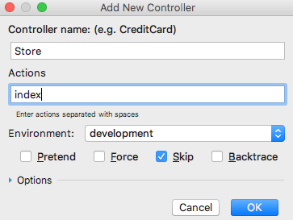
Creating a Store controller
So far, the Depot application has a functional Products page which the seller can use to add, remove and update products to the system. But there is no interface yet for the customer to browse the catalog and add items into their shopping cart. So let’s work on that now.
In RubyMine, click on Tools > Run Rails Generator > controller and create a new controller named Store. The Store controller should have only one action, named index.

Slide 15
Modifying the homepage route
If we run the application now, the homepage is still the “You’re on Rails” screen. Let’s fix that and make the homepage the new Store controller.
Open config/routes.rb and change:
get 'store/index'
To:
root 'store#index', as: 'store_index'
Run the application and verify that the homepage is now the Store controller: http://localhost:3000/
Notes:
This file has its own DSL. “root” means the root / home page.
“store#index” means the index action of the store controller. “as: 'store_index'” means the root has a specified name, which we can use later, e.g. with store_index_url or store_index_path.

Slide 16
Building the Store
Let’s modify the index method in the Store controller to get a list of Products:
@products = Product.order(:title)
This is ActiveRecord magic! Rails is selecting all the product records ordered by title from the database, instantiating them as Product models, and storing this enumerable list of products in an instance variable called @products.
Next, update the view app/views/store/index.html.erb using the file from day3
Also, update the stylesheet app/assets/stylesheets/store.scss using the file from day3
Reload http://localhost:3000/ and verify that the products are being displayed

Slide 17
ActionView Helper methods
Rails gives us a large number of helpers and libraries. We can use the number_to_currency method to format the prices displayed in the catalog.
Update store/index.html.erb view and format the prices with number_to_currency()
Bonus points: check out the documentation https://apidock.com/rails/ActionView/Helpers/NumberHelper/number_to_currency and use a currency other than USD $

Slide 18
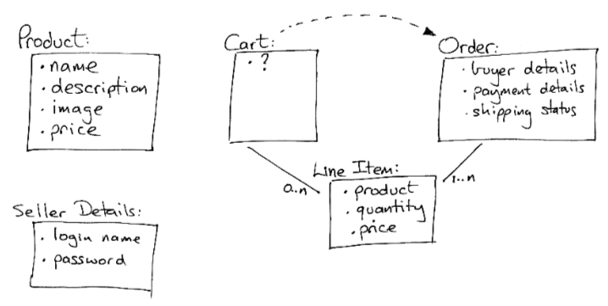
What about the shopping cart?
So far we have been working with a single table, products.
Let’s expand our system to include a shopping cart with line items.

Slide 19
Adding the Cart and LineItem
We will use Rails scaffolding to create Cart and LineItems for us:
Run a Rails generator for scaffold with the model name “Cart” (no fields)
Migrate the database
Run a Rails generator for scaffold with the model name “LineItem” and the following fields: product:references cart:belongs_to
Migrate the database again

Slide 20
Linking the user session to the shopping cart
Let’s create a module to link the session to the shopping cart which we can use in different controllers:
# app/controllers/concerns/current_cart.rb
module CurrentCart private
def set_cart
@cart = Cart.find(session[:cart_id])
rescue ActiveRecord::RecordNotFound
@cart = Cart.create
session[:cart_id] = @cart.id
end
end

Slide 21
Linking the LineItem to the Product and the Cart
Notice how Rails has automatically defined some relationships for us in app/models/line_item.rb:
class LineItem < ApplicationRecord
belongs_to :product
belongs_to :cart
end

Slide 22
Linking the Cart to LineItem
Modify the cart model to reference line_items:
class Cart < ApplicationRecord
has_many :line_items, dependent: :destroy
end

Slide 23
Linking Product to LineItem
Modify the product model to reference line_items:
class Product < ApplicationRecord
has_many :line_items
before_destroy :ensure_not_referenced_by_any_line_item
# existing code
# ...
# see next page
Notes:
We have defined a hook, ensure_not_referenced_by_any_line_item - a method which Rails calls automatically for us at a given point in the object’s life

Slide 24
Linking Product to LineItem (continued)
# product.rb continued from above
private
def ensure_not_referenced_by_any_line_item
unless line_items.empty?
errors.add(:base, 'Line Items present')
throw :abort
end
end
end

Slide 25
Wiring everything up
Modify app/views/store/index.html.erb to include an Add to Cart button immediately after the code which displays the price:
<%= button_to 'Add to Cart', line_items_path(product_id: product) %>
Modify the LineItems controller to include the CurrentCart module and to call it when we create a new LineItem:
class LineItemsController < ApplicationController
include CurrentCart
before_action :set_cart, only: [:create]
# existing code...

Slide 26
Wiring everything up (continued)
Modify the create method in LineItems controller:
def create
product = Product.find(params[:product_id])
@line_item = @cart.line_items.build(product: product)
@line_item = LineItem.new(line_item_params)
Also modify the redirect after save, also in the create method of LineItemsController:
if @line_item.save
format.html { redirect_to @line_item.cart, notice: 'Line item was successfully created.' }
format.html { redirect_to @line_item, notice: 'Line item was successfully created.' }

Slide 27
Nearly there!
Copy the application.scss file from day3 to app/assets/stylesheets/ (and delete the old application.css file)
Copy the show.html.erb file from day3 to app/views/carts/show.html.erb (replacing the old file)
Finally! let’s add something to the shopping cart and see what happens...

Slide 28
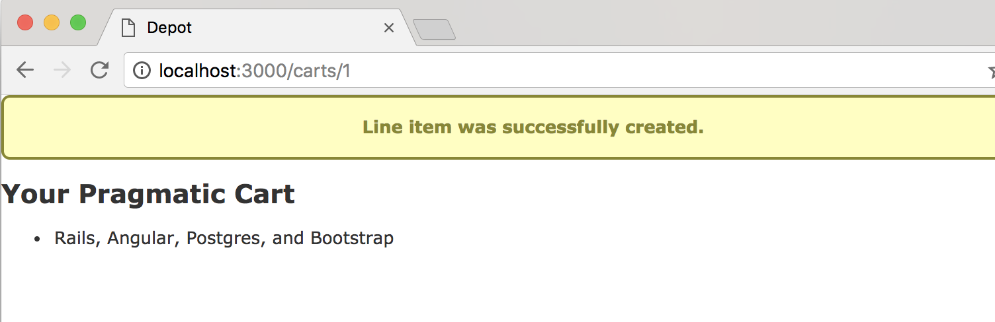
Shopping Cart in action
Add some items to the shopping cart

Slide 29
Navigating relational data in the console
Now that we have some relational data, let’s see how we can interrogate in a console. Open a Rails console and try:
cart = Cart.first
puts "There are #{cart.line_items.count} line item(s) in the shopping cart"
cart.line_items.each {|li| puts "Product ID #{li.product_id} : #{li.product.title}" }
Now see what happens if you attempt to delete one of the products referenced in the shopping cart:
Product.find(XXX).destroy! # replace XXX with the id printed out above
Notes:
Discuss why the destroy! fails; where is this code and does it belong in a controller or model?

Slide 30
Rake
Rake is “Ruby Make”. It is a utility for running tasks: such as migrating or rolling-back the database or pre-compiling the asset pipeline (e.g. in preparation for deploying to production). You can get a list of all the Rake tasks available by running:
$ rake -T
Some useful Rake tasks include:
$ rake db:migrate - migrates the database
$ rake db:rollback - rolls the database back
$ rake routes - lists all the known routes defined in the system
$ rake db:reset - wipes and re-creates the database (don’t run in production!)
$ rake secret - generates a random cryptographic key

Slide 31
Custom Rake tasks
Often we need some custom Rake tasks: to do occasional or routine things outside of the general application interface. These tasks should be stored in the lib/tasks/ folder. The general structure of a Rake task e.g. lib/tasks/my_custom_task.rake is:
namespace :my_namespace do
desc "This is my custom task for doing something"
task my_custom_task: :environment do
puts "Doing some custom action..."
puts "There are #{Product.count} products in the system"
puts "All done."
end
end

Slide 32
Workshop: custom Rake task to import into Depot
Create a custom Rake task to read a few records from the EPMC API and create corresponding products in Depot. A suitable URL to query might be https://www.ebi.ac.uk/europepmc/webservices/rest/search?query=frog&format=json&pageSize=5
Things to consider:
Set the Title to be the title supplied by EPMC, truncated to 100 characters
Set the Description to be the authors supplied by EPMC
Set the Price to be a random number between £0.50 - £10.99 and cost_price to be price - 0.49
Use a placeholder image for the image_url
Make your importer idempotent: i.e. re-runnable without duplicates or deletes
Notes:
See day 1 slides for parsing JSON
Active record has two relevant methods: .first_or_create! .first_or_initialize

Slide 33
Quiz
How do you ensure a migration is irreversible?
How should you best alter the behaviour of a committed migration?
What is the difference between .update_attributes! and .update_attributes
What is a hook?
What does this ActiveRecord command translate to in SQL?:
Person.where(surname: 'Smith').where(role: 'Chef').count

